Slide 1
Week 12
Alexey V. Zimin
JHU BME 580.417/707

Slide 2
Paper presentation
You have 10 minutes: no outline, 10 slides maximum
The best part is the abstract – it usually contains statement of the problem and conclusions
It is OK if you finish 1-2 minutes early, please try to not go over time limit
Please bring your talk to class in PDF or PPT format on a USB stick, or you can present from your laptop (USB-C or HDMI)
Don’t try to describe everything, describe the key point or key algorithm in the paper
You will get full credit for presenting

Slide 3
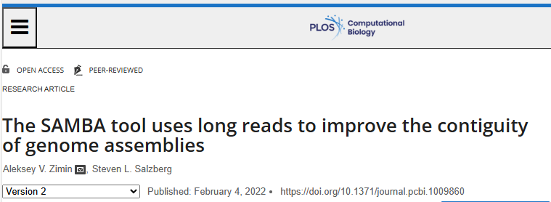
The SAMBA tool uses long reads to improve the contiguity of genome assemblies

Slide 4
Scaffolding with long reads
SAMBA (Scaffolding Assemblies with Multiple Big Alignments) tool uses long reads to re-scaffold contigs from an existing genome assembly and to fill gaps in those scaffolds
The tool is designed to use 10-30x coverage in long read data with a set of existing contigs, although it can function with lower or higher coverage as well.
Open-source, available on github, included into MaSuRCA genome assembly package

Slide 5
The SAMBA algorithm: links
Align reads to the contigs with minimap2
Use reads that align to two different contigs in such a way that they can be joined to generate links between contigs:
Sum of overhangs<500bp (default) on each side
Overlap > 2500bp on each side
Mode than one read required to suggest a merge between two contigs, implied gap size must be consistent
Overhang
Long read
Overlap
Overlap
Contig 1
Contig 2
Overhang

Slide 6
The SAMBA algorithm: links
The set of links yields the graph of contigs: Contig1 Contig2 gap orientation Contig1 Contig3 gap orientation Contig2 Contig3 gap orientation …
Overhang
Long read
Overlap
Overlap
Contig 1
Contig 2
Overhang

Slide 7
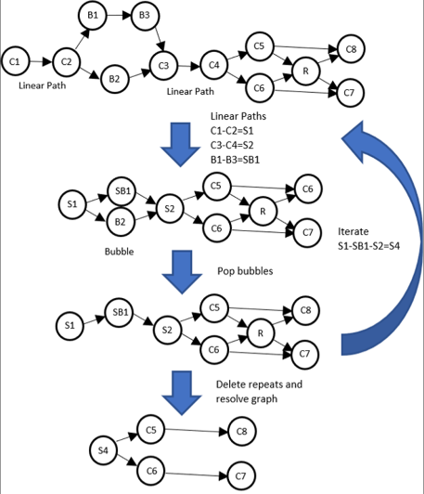
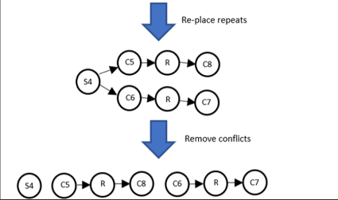
The SAMBA algorithm: Graph of contigs
Resolve three features: 1. Linear paths
2. Bubbles
3. Short repeats

Slide 8
The SAMBA algorithm: Consensus
Long reads
Contig 1
Contig 2 (repeat)
Contig 3

Slide 9
The SAMBA algorithm: Consensus
Create a “patch”
Contig 1
Contig 2 (repeat)
Contig 3

Slide 10
The SAMBA algorithm: Consensus
Merge
Merged contig

Slide 11
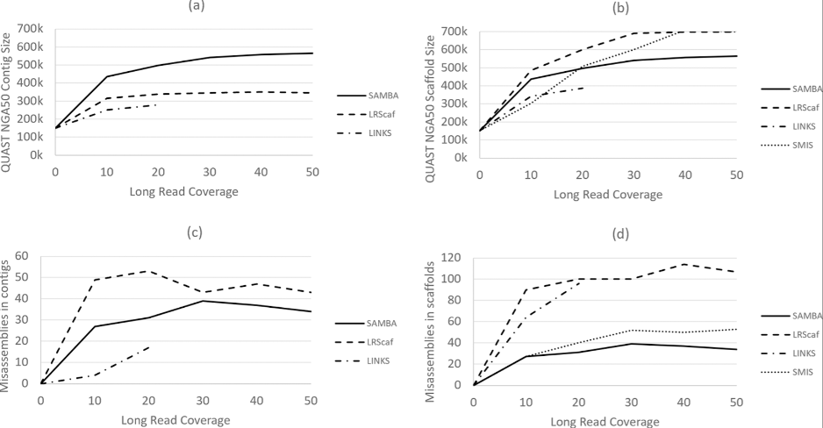
Result: Arabidopsis thaliana assembly, PacBio reads
Longer contigs, fewer errors compared to LRScaf, SMIS and LINKS

Slide 12
Summary
SAMBA is an effective tool aimed at improving contiguity of existing genome assemblies with long reads
No need to re-assemble, useful in cases where original data is no longer available
Can use both PacBio and Oxford nanopore long reads

Slide 13
Lab #6: Training and scoring with PWM and WAM
Lab #6: Due Friday November 21st at 8:00pm. In this lab assignment you will implement training and scoring with Positional Weight and Weight Array (graduate only) matrices. Submit through GradeScope’s autograder.
Data: training https://github.com/alekseyzimin/BME-Algorithms-for-Analysis-of-Genomic-Data/raw/refs/heads/main/training.txt testing https://github.com/alekseyzimin/BME-Algorithms-for-Analysis-of-Genomic-Data/raw/refs/heads/main/testing20.txt. When computing logs of probabilities, add 1e-16 to the probability to avoid getting log(0)
The assignment is to write the following functions in python and submit them through autograder in train_score_pwm.py file:
(G:10pts,U:10pts) load_sequences(file) : reads strings from file, one string per line, returns array of strings
(G:25pts,U:50pts) compute_pwm(sequences) : computes positional weights from training data in the array of strings sequences, returns dictionary of positional weights pwm[base][position]=weight; base is “ACGT”, position is from 0 to len(sequences[0])-1
(G:20pts,U:40pts) score_pwm(sequences,pwm) : returns array of numerical positional weight scores for array of DNA sequences sequences and positional weight matrix (dictionary) pwm
Graduate students only:
(G:25pts) compute_wam(sequences) : computes Weight Array Matrix from training data in the array of strings sequences, returns dictionary of weights wam[tuple][position]=weight; tuple is “AA, “AC”,...,”TT”, position is from 0 to len(sequences[0])-2
(G:20pts) score_wam(sequences,pwm,wam) : returns array of numerical Weight Array scores for array of DNA sequences sequences, positional weight matrix (dictionary) pwm, and weight array matrix (dictionary) wam

Slide 14
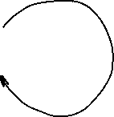
Viterbi algorithm for HMMs
Start
0.5
0.5
C
A 0.2
C 0.3
G 0.3
T 0.2
N
A 0.3
C 0.2
G 0.2
T 0.3
0.5
0.5
0.6
0.4
Let's consider the following simple HMM for coding/non-coding regions of DNA. This model is composed of 2 states, C (coding) and N (non-coding).

Slide 15
Viterbi algorithm for HMMs
Start
0.5
0.5
C
A 0.2
C 0.3
G 0.3
T 0.2
N
A 0.3
C 0.2
G 0.2
T 0.3
0.5
0.5
0.6
0.4
Consider the sequence S = GGCACTGAA
There are several paths through hidden states (C and N) that lead to this sequence, e.g. NNCCCCNNN
Prob(S) through this path is 0.5*0.2*0.6*0.2*0.4*0.3*...

Slide 16
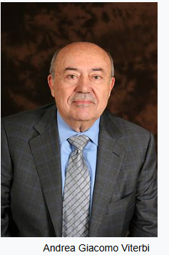
Viterbi algorithm for HMMs
Start
0.5
0.5
C
A 0.2
C 0.3
G 0.3
T 0.2
N
A 0.3
C 0.2
G 0.2
T 0.3
0.5
0.5
0.6
0.4
Andrew James Viterbi
Image credit: Wikipedia
Consider the sequence S = GGCACTGAA
There are several paths through hidden states (C and N) that lead to this sequence, but they do not have the same probability
The Viterbi algorithm allows us to compute the most probable (best) path

Slide 17
Viterbi algorithm for HMMs
Start
Consider the sequence S = GGCACTGAA
The probability of the best path ending in state l with observation i is:
0.5
0.5
C
A 0.2
C 0.3
G 0.3
T 0.2
N
A 0.3
C 0.2
G 0.2
T 0.3
0.5
0.5
0.6
0.4
$$p_{l}\left(i,x\right)=e_{l}\left(i\right)\max_{k=(N,C)}{(}p_{k}\left(j,x−1\right)∗p_{kl})$$
Probability to observe element i in state l
Probability of the best path ending at position x-1 in state k with element j
Probability of transition from state k to state l

Slide 18
Viterbi algorithm for HMMs
Start
Consider the sequence S = GGCACTGAA
The probability of the best path ending in state l with observation i is:
In our example, the probability of the best path ending in state l=C with “A” at the 4th position is:
0.5
0.5
C
A 0.2
C 0.3
G 0.3
T 0.2
N
A 0.3
C 0.2
G 0.2
T 0.3
0.5
0.5
0.6
0.4
$$p_{l}\left(i,x\right)=e_{l}\left(i\right)\max_{k=(N,C)}{(}p_{k}\left(j,x−1\right)∗p_{kl})$$
$$p_{C}\left(A,4\right)=e_{C}\left(A\right)\max_{k}{(}p_{N}\left(C,3\right)∗p_{NC},p_{C}\left(C,3\right)∗p_{CC})$$

Slide 19
Viterbi algorithm for HMMs
For simplicity, let’s convert everything to log₂(p):
Start
0.5
0.5
C
A 0.2
C 0.3
G 0.3
T 0.2
N
A 0.3
C 0.2
G 0.2
T 0.3
0.5
0.5
0.6
0.4

Slide 20
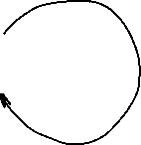
Viterbi algorithm for HMMs
For simplicity, let’s convert everything to log₂(p):
This allows us to add probabilities instead of multiplying, which is more efficient and accurate
Start
-1
-1
C
A -2.322
C -1.737
G -1.737
T -2.322
N
A -1.737
C -2.322
G -2.322
T -1.737
-1
-1
-0.737
-1.322

Slide 21
Viterbi algorithm for HMMs
Start
S = GGCACTGAA
Log probability that the first G was emitted by state C:
Log probability that the first G was emitted by state N:
-1
-1
C
A -2.322
C -1.737
G -1.737
T -2.322
N
A -1.737
C -2.322
G -2.322
T -1.737
-1
-1
-0.737
$$p_{C}\left(G,1\right)=−1−1.737=−2.737$$
-1.322
$$p_{N}\left(G,1\right)=−1−2.322=−3.322$$

Slide 22
Viterbi algorithm for HMMs
Start
S = GGCACTGAA
Log probability that the second G was emitted by state C:
Log probability that the second G was emitted by state N:
-1
-1
C
A -2.322
C -1.737
G -1.737
T -2.322
N
A -1.737
C -2.322
G -2.322
T -1.737
-1
-1
-0.737
-1.322
$$p_{C}\left(G,2\right)=−1.737+\max\left(p_{C}\left(G,1\right)+p_{CC},p_{N}\left(G,1\right)+p_{NC}\right)=−5.474$$
$$p_{N}\left(G,2\right)=−2.322+\max\left(p_{C}\left(G,1\right)+p_{CN},p_{N}\left(G,1\right)+p_{NN}\right)=−6.059$$

Slide 23
Viterbi algorithm for HMMs
Start
S = GGCACTGAA
Log probability that the second G was emitted by state C:
Log probability that the second G was emitted by state N:
-1
-1
C
A -2.322
C -1.737
G -1.737
T -2.322
N
A -1.737
C -2.322
G -2.322
T -1.737
-1
-1
-0.737
-1.322
$$p_{C}\left(G,2\right)=−1.737+\max\left(p_{C}\left(G,1\right)+p_{CC},p_{N}\left(G,1\right)+p_{NC}\right)=−5.474$$
-2.737-1
-3.322-1.322
$$p_{N}\left(G,2\right)=−2.322+\max\left(p_{C}\left(G,1\right)+p_{CN},p_{N}\left(G,1\right)+p_{NN}\right)=−6.059$$
-2.737-1
-3.322-0.737

Slide 24
Viterbi algorithm for HMMs
Start
S = GGCACTGAA
Log probability that the second G was emitted by state C:
Log probability that the second G was emitted by state N:
-1
-1
C
A -2.322
C -1.737
G -1.737
T -2.322
N
A -1.737
C -2.322
G -2.322
T -1.737
-1
-1
-0.737
-1.322
$$p_{C}\left(G,2\right)=−1.737+\max\left(p_{C}\left(G,1\right)+p_{CC},p_{N}\left(G,1\right)+p_{NC}\right)=−5.474$$
-2.737-1
-3.322-1.322
$$p_{N}\left(G,2\right)=−2.322+\max\left(p_{C}\left(G,1\right)+p_{CN},p_{N}\left(G,1\right)+p_{NN}\right)=−6.059$$
-2.737-1
-3.322-0.737

Slide 25
Viterbi algorithm for HMMs
Start
S = GGCACTGAA
Iteratively compute probabilities, record values and where you came from in two matrices (arrays):
-1
-1
C
A -2.322
C -1.737
G -1.737
T -2.322
N
A -1.737
C -2.322
G -2.322
T -1.737
-1
-1
-0.737
-1.322
 | G | G | C | A | C | T | G | A | A
C | -2.73 | -5.47 | -8.21 | -11.53 | -14.01 | ... |  |  | -25.65
N | -3.32 | -6.06 | -8.79 | -10.94 | -14.01 | ... |  |  | -24.49

Slide 26
Viterbi algorithm for HMMs
Start
S = GGCACTGAA
Backtrack:
-1
-1
C
A -2.322
C -1.737
G -1.737
T -2.322
N
A -1.737
C -2.322
G -2.322
T -1.737
-1
-1
-0.737
-1.322
 | G | G | C | A | C | T | G | A | A
C | -2.73 | -5.47 | -8.21 | -11.53 | -14.01 | ... |  |  | -25.65
N | -3.32 | -6.06 | -8.79 | -10.94 | -14.01 | ... |  |  | -24.49

Slide 27
Viterbi algorithm for HMMs
Start
S = GGCACTGAA
Backtrack:
The most probable path is: CCCNNNNNN, its probability is 2^{-24.49}
-1
-1
C
A -2.322
C -1.737
G -1.737
T -2.322
N
A -1.737
C -2.322
G -2.322
T -1.737
-1
-1
-0.737
-1.322
 | G | G | C | A | C | T | G | A | A
C | -2.73 | -5.47 | -8.21 | -11.53 | -14.01 | ... |  |  | -25.65
N | -3.32 | -6.06 | -8.79 | -10.94 | -14.01 | ... |  |  | -24.49

Slide 28
A biased example
Start
S = GGCACTGAA
Log probability that the second G was emitted by state C:
Log probability that the second G was emitted by state N:
-1
-1
C
A -2.322
C -1.737
G -1.737
T -2.322
N
A -1.737
C -2.322
G -2.322
T -1.737
-inf
0
0
-inf
$$p_{C}\left(G,2\right)=−1.737+\max\left(p_{C}\left(G,1\right)+p_{CC},p_{N}\left(G,1\right)+p_{NC}\right)=−4.474$$
-2.737
-inf
$$p_{N}\left(G,2\right)=−2.322+\max\left(p_{C}\left(G,1\right)+p_{CN},p_{N}\left(G,1\right)+p_{NN}\right)=−5.644$$
-inf
-3.322

Slide 29
A biased example
Start
S = GGCACTGAA
Iteratively compute probabilities, record values and where you came from in two matrices (arrays):
-1
-1
C
A -2.322
C -1.737
G -1.737
T -2.322
N
A -1.737
C -2.322
G -2.322
T -1.737
-inf
0
0
-inf
 | G | G | C | A | C | T | G | A | A
C | -2.73 | -4.47
N | -3.32 | -5.64

Slide 30
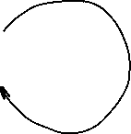
A biased example
Start
S = GGCACTGAA
Iteratively compute probabilities, record values and where you came from in two matrices (arrays):
-1
-1
C
A -2.322
C -1.737
G -1.737
T -2.322
N
A -1.737
C -2.322
G -2.322
T -1.737
-inf
0
0
-inf
 | G | G | C | A | C | T | G | A | A
C | -2.73 | -4.47 | -6.20 | -8.52 | -10.26 | -12.59 | -14.32 | -16.64 | -18.97
N | -3.32 | -5.64 | -7.97 | -9.70 | -12.03 | -13.77 | -16.08 | -17.82 | -19.56

Slide 31
A biased example
Start
S = GGCACTGAA
Iteratively compute probabilities, record values and where you came from in two matrices (arrays):
-1
-1
C
A -2.322
C -1.737
G -1.737
T -2.322
N
A -1.737
C -2.322
G -2.322
T -1.737
-inf
0
0
-inf
 | G | G | C | A | C | T | G | A | A
C | -2.73 | -4.47 | -6.20 | -8.52 | -10.26 | -12.59 | -14.32 | -16.64 | -18.97
N | -3.32 | -5.64 | -7.97 | -9.70 | -12.03 | -13.77 | -16.08 | -17.82 | -19.56

Slide 32
The Viterbi algorithm: summary
The Viterbi algorithm is used to compute the most probable path (as well as its probability). It requires knowledge of the parameters of the HMM model and a particular output sequence and it finds the state sequence that is most likely to have generated that output sequence.
It works by finding a maximum over all possible state sequences.
In sequence analysis, this method can be used for example to predict coding vs non-­coding sequences.
Similar (in spirit) to Smith-Waterman alignment!

Slide 33
Making use of annotated genomes
We assembled and annotated a reference genome:
We know the DNA sequence of the genome
We know positions of all functional elements: exons, introns, transcript and protein coding sequences
How can we use this information:
We can establish the function of genes by protein homology
We can relate genotype to phenotype by looking at a population of individuals and by cataloguing their:
Phenotypes: physical appearance, etc
Genotypes: set of differences between their genome and the reference

Slide 34
Genome Wide Association Study
A genome-wide association study (GWAS) is a method used to identify genetic variants, that are associated with a particular disease or trait by comparing the genomes of many individuals.
It involves comparing the entire genomes of people who have a disease with those who don't, looking for genetic differences that appear more frequently in the affected group. The results help scientists understand the genetic basis of diseases and other traits.

Slide 35
How GWAS works
Participant groups: Researchers assemble two large groups of people: a "case" group with a specific disease or trait and a "control" group without it.
DNA collection: DNA is collected from all participants, often through a blood sample or a cheek swab.
Genotyping: The DNA is then analyzed to identify common genetic variants, typically single nucleotide polymorphisms (SNPs), across the entire genome.
Association testing: Statistical tests are performed to see if any particular SNP variant is found significantly more often in one group than the other. For example, more people with heart disease might have a "C" SNP in a specific gene compared to a "T" SNP, which is more common in the control group.
Interpretation: Variants found more frequently in the case group are considered to be associated with the disease or trait.

Slide 36
What is GWAS used for
Understanding disease: GWAS provides a way to identify genetic risk factors for many diseases, including some types of cancer, heart disease, and neurological disorders.
Improving research: By pinpointing these associated variants, researchers can investigate the specific genes and biological mechanisms that contribute to disease risk.
Developing treatments: Insights from GWAS can serve as a first step toward understanding a disease's underlying causes and eventually lead to the development of new treatments.

Slide 37
The first step in GWAS: Variant Calling
Sequencing: A DNA sample is sequenced to generate many short reads containing genetic information.
Alignment: The generated short reads are aligned (mapped) to a known reference genome.
Variant Identification: Bioinformatic algorithms compare the aligned reads to the reference to identify positions where they differ, indicating a variant.
Variant Call Formatting: The identified variants are compiled into a standardized Variant Call Format (VCF) file.

Slide 38
Types of variants
Single Nucleotide Variants (SNVs): A change in a single DNA base pair, such as a single nucleotide polymorphism (SNP).
Insertions/Deletions (Indels): Short segments of DNA that are inserted or deleted.
Structural Variants (SVs): Larger-scale changes to the genome, including deletions, duplications, inversions, and translocations.

Slide 39
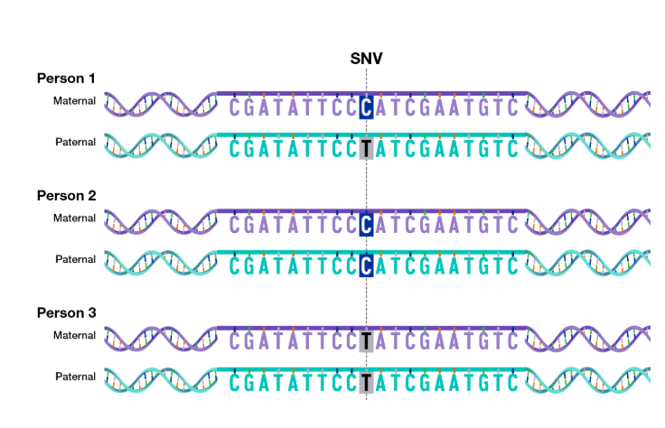

Single nucleotide variants (SNV or SNP)
Reference:
Source: genome.gov

Slide 40
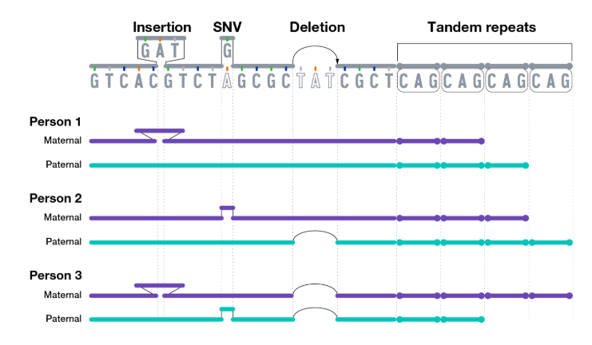
Other variants
Source: genome.gov

Slide 41
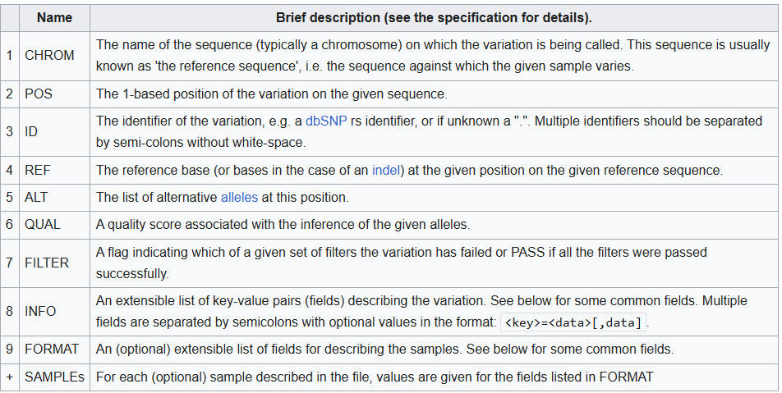
VCF file format
Variant calls are usually reported in VCF format:

Slide 42
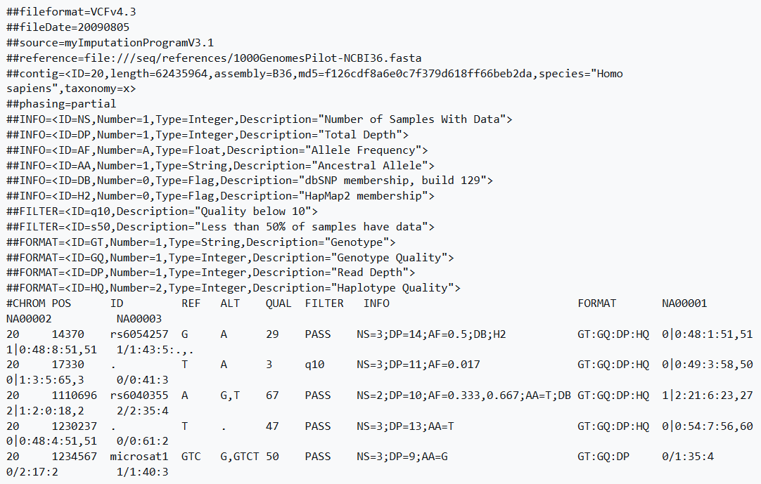
VCF file format: example

Slide 43
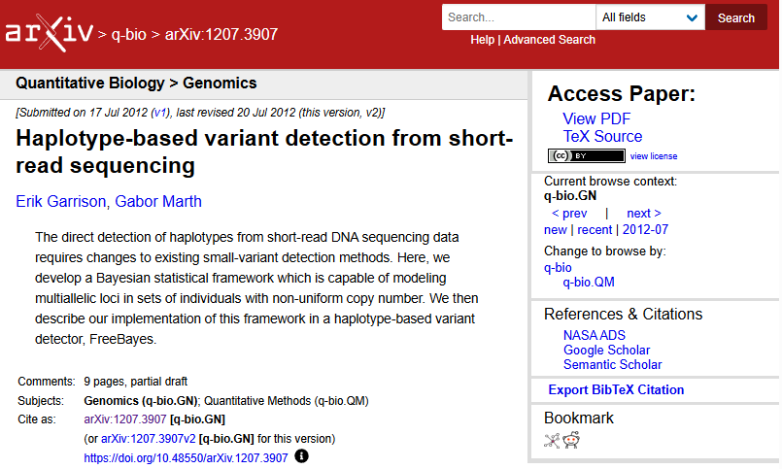
Variant calling software
I recommend freebayes – it works very well, very stable and easy to install (static executable)
Other programs:
GATK
Google’s deepvariant
Strelka2
Octopus

Slide 44
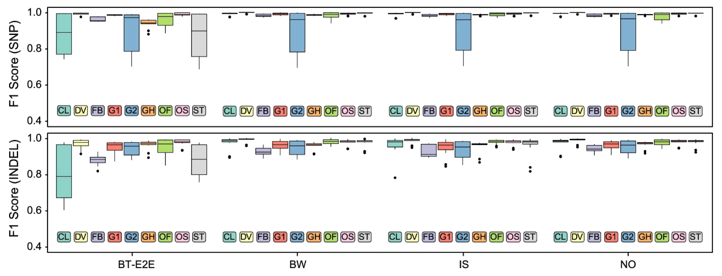
Performance of variant callers
Deepvariant is the most expensive to run and performs best. Overall differences are small(Barbitoff et al, 2022):

Slide 45
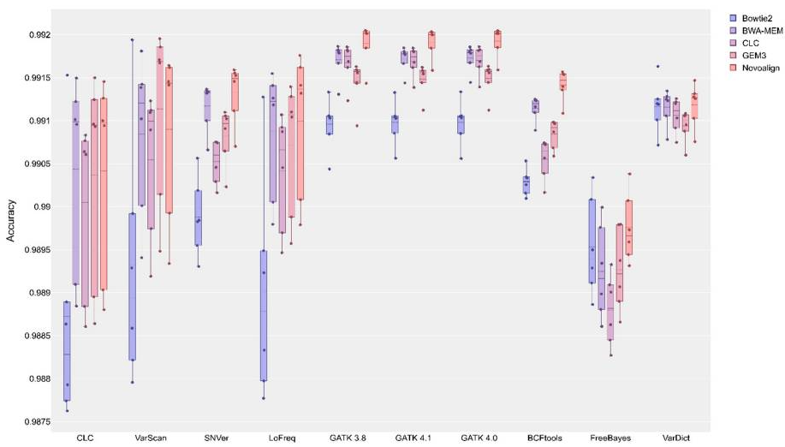

Performance of variant callers
Another comparison—note the Y axis scale (Barbitoff et al, 2022):

Slide 46
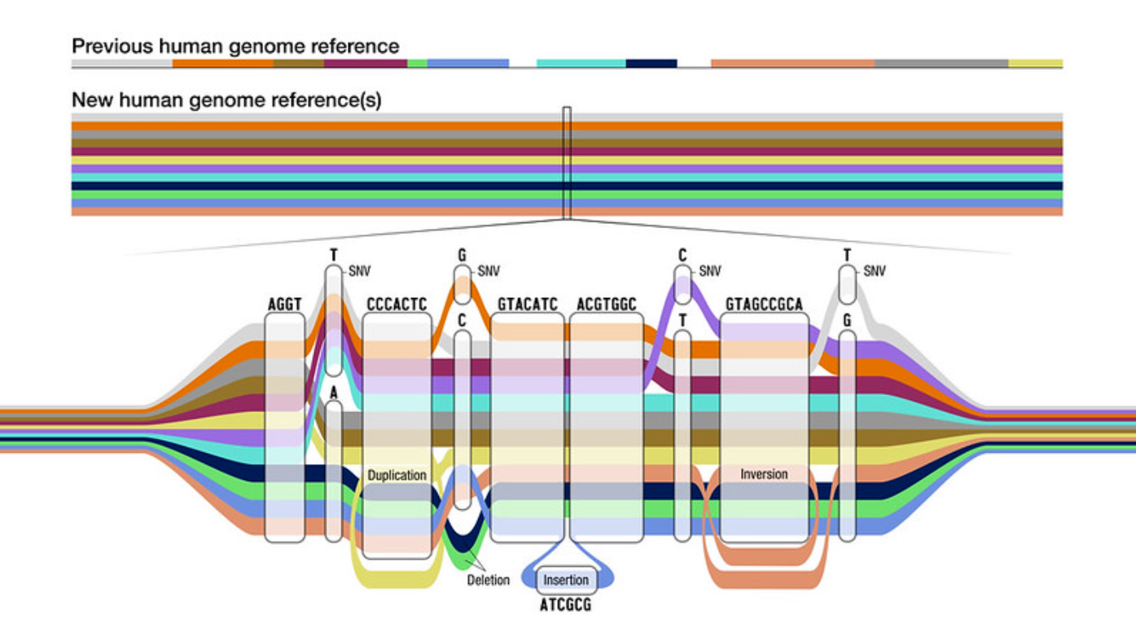
Variant calling: Problems
Source: nhgri.gov
Repeat regions and errors in the reads may lead to incorrect or missing alignments
Individual genomes differ (mostly in repetitive sequences): reads from individual A and B that came from sequences not present in the reference genome may align (poorly) to another place in the reference, thus contributing to spurious variant calls
Solution: pangenome, align reads to multiple genomes, use the best alignment
Human Pangenome Reference Consortium (HPRC) https://humanpangenome.org/

